Slide 1
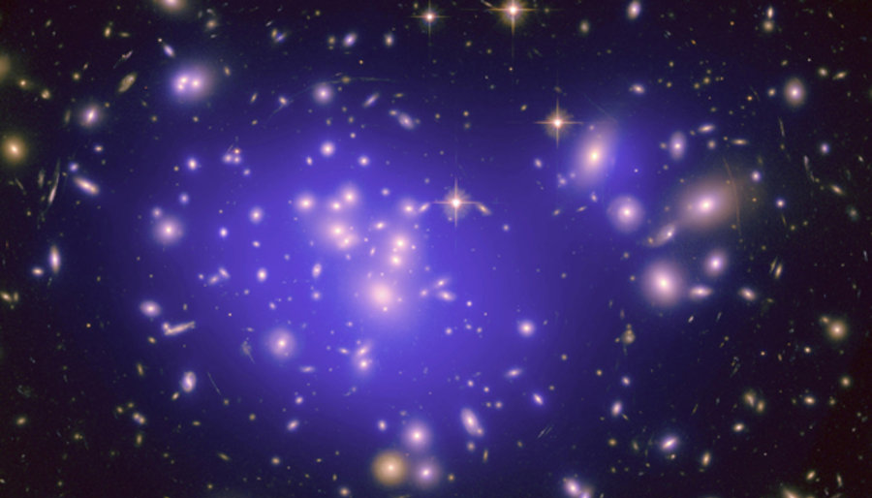
Introduction to Dark Matter:
History & Astrophysical Evidences
Astroparticle Physics
Part 5 – WS 2019
Federico Ambrogi
<number>
Notes:
<number>

Slide 2

Overview
Why do we talk about dark matter i.e. what are the evidences for Dark Matter existence?
What do we think Dark matter is?
What is the role of Dark Matter in the evolution of the Universe?
How can we search for Dark Matter?
Astroparticle Physics - Part 4 Introduction to Dark Matter
<number>
Notes:
<number>

Slide 3
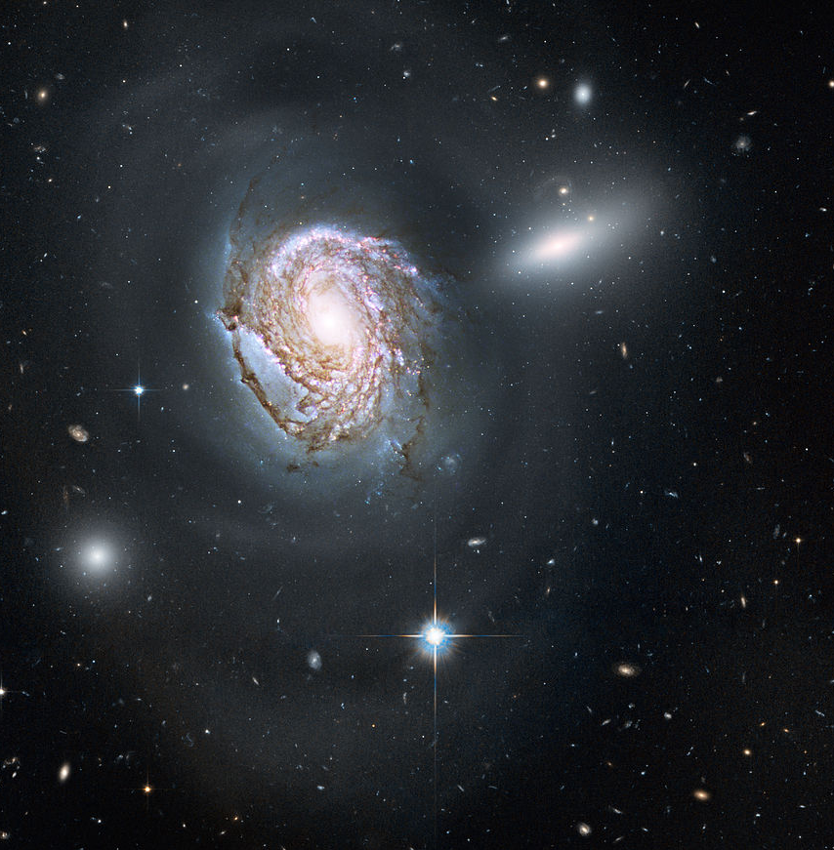
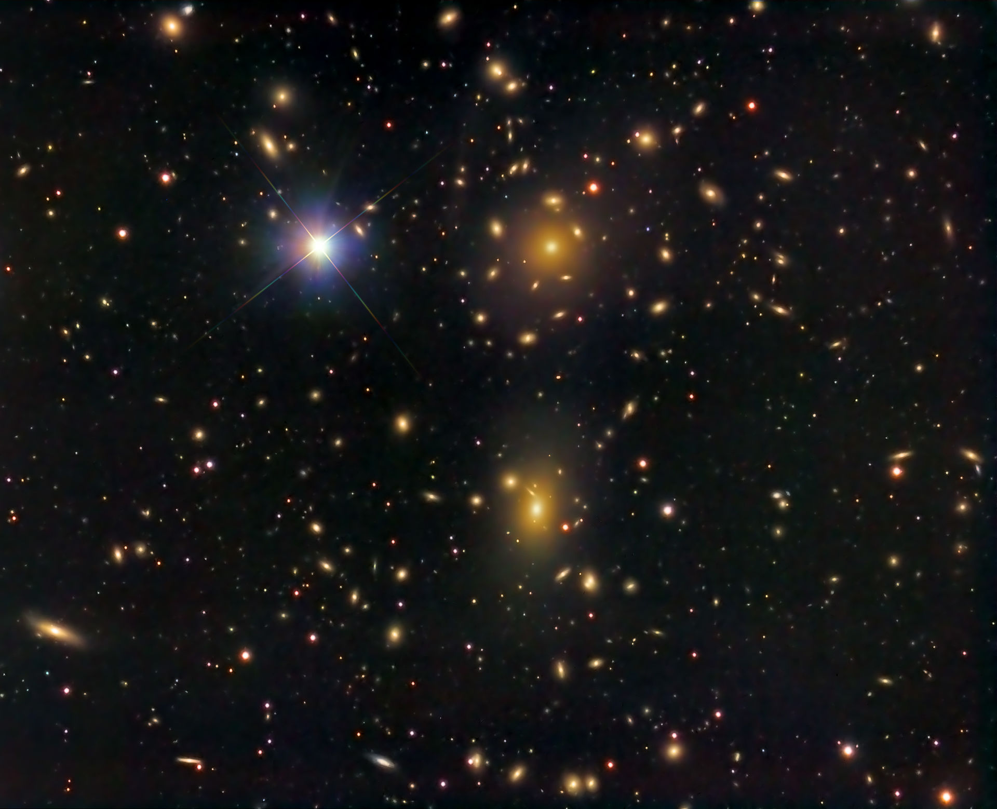
Introduction: An Astrophysical Puzzle
http://hosting.astro.cornell.edu/academics/courses/astro201/vt.htm
Dark Matter is a building block of modern Cosmology and of the LambdaCDM model
Pioneer of DM studies: the Swiss-American astronomer Fritz Zwicky (1933)
He studied the velocity dispersion of galaxies inside the Coma cluster
(a large cluster of galaxies with more than 1,000 identified galaxies) and found a gravitational anomaly
He was the first to use the virial theorem to determine the mass of a galaxy cluster
He estimated the total mass M_{tot} of Coma as
M_{tot} = 800 * <m>
where <m>=10⁹ Mo is the average mass of the galaxies in a radius of the system equal to 10⁶ light-years
He calculated the potential energy, the average kinetic energy, applied the virial theorem,
obtained a velocity dispersion of ~ 80 km/s
https://arxiv.org/pdf/1605.04909.pdf
!!! The observed average velocity dispersion along the line-of-sight was approximately 1000 km/s >> 80 km/s !!!
Astroparticle Physics - Part 4 Introduction to Dark Matter
<number>
Notes:
<number>

Slide 4
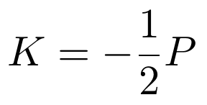
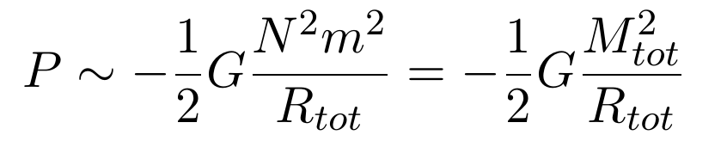
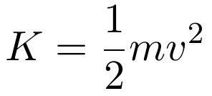
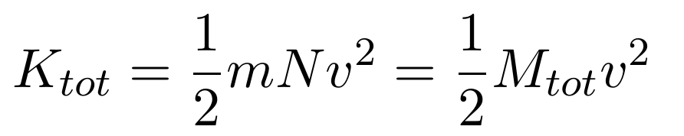
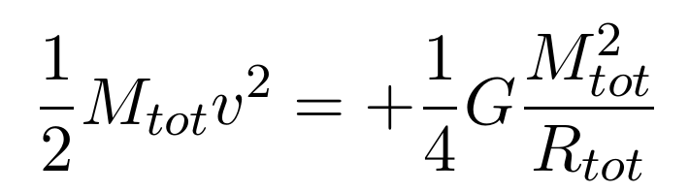
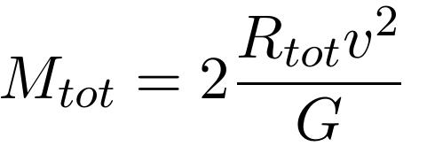
Estimating the Virial Mass of the Cluster
Virial Theorem:
http://hosting.astro.cornell.edu/academics/courses/astro201/vt.htm
Gravitational
Potential Energy:
Kinetic Energy:
Assuming the system is composed of N galaxies
with average mass <m> = m:
Apply the
Virial Theorem:
Astroparticle Physics - Part 4 Introduction to Dark Matter
<number>
Notes:
<number>

Slide 5
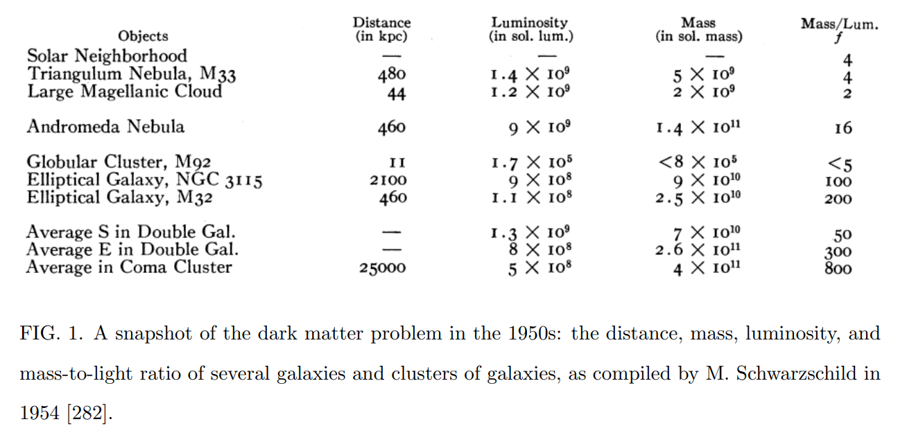
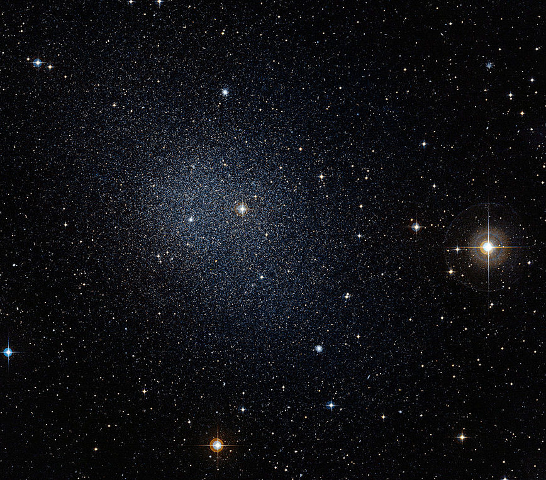
Introduction: An Astrophysical Puzzle
Several galaxies showed an
‘excess of mass’ wrt the
total visible luminous emission
Useful astronomical quantity: Mass to Light ratio, M/L
It is defined as the ratio of the mass and the luminosity of an object
Typically use the Solar value M⊙ /L ⊙ ~ 5100 kg/W
Segue 1 dwarf spheroidal galaxy: M/L > 3.400, contains only a few hundred stars, yet has a large mass
“Segue 1: The Darkest Galaxy” (Ideal objects to study DM annihilation with indirect searches)
Optical image of an “Ultra faint”
dwarf galaxy
Astroparticle Physics - Part 4 Introduction to Dark Matter
<number>
Notes:
<number>

Slide 6
Introduction: An Astrophysical Puzzle
“If this would be confirmed, we would get the surprising result that dark matter (dunkle materie)
is present in much greater amount than luminous matter“
“ [In order to derive the mass of galaxies from their luminosity] we must know how much dark matter is incorporated in nebulae in the form of cool and cold stars, macroscopic and microscopic solid bodies, and gases“
Astroparticle Physics - Part 4 Introduction to Dark Matter
<number>

Slide 7
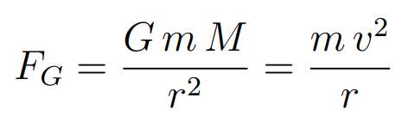
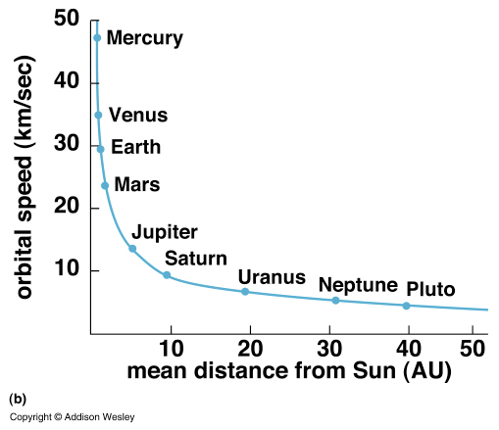
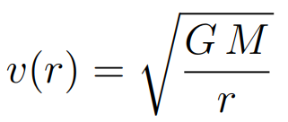
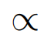
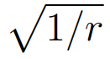
Rotation Velocity
Consider the mean orbital speed of planets around the Sun. The gravitational attractive force must be equal to the centripetal force:
This is observed for the planets in the solar system
(sometimes called “Keplerian fall”)
This should also holds for other dynamical system e.g. the motion of stars in spiral galaxies orbitating around the galactic centre (i.e. supermassive black hole), or blob of hydrogen
Astroparticle Physics - Part 4 Introduction to Dark Matter
<number>
Notes:
<number>

Slide 8
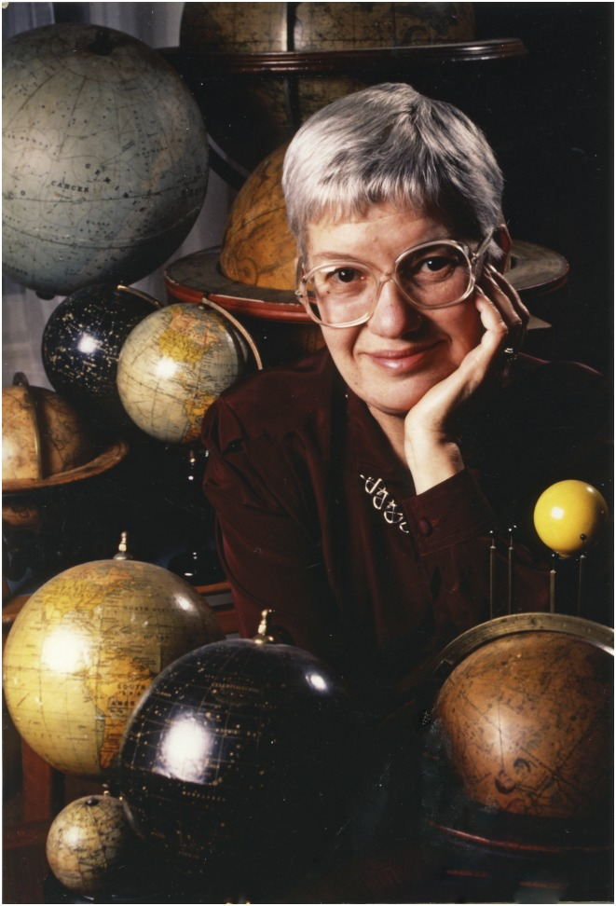
Rotation Velocity of Spiral Galaxies
Vera C. Rubin: Pioneering American astronomer (1928–2016)
https://www.ncbi.nlm.nih.gov/pmc/articles/PMC5338491/
“Vera Cooper Rubin, an icon of astronomy whose work revolutionized our understanding of the universe by confirming the existence of dark matter”
“Her research showed that spiral galaxies rotate quickly enough that they should fly apart, if the gravity of their constituent stars was all that was holding them together; because they stay intact, a large amount of unseen mass must be holding them together, a conundrum that became known as the galaxy rotation problem.
Rubin's calculations showed that galaxies must contain at least five to ten times as much dark matter as ordinary matter. Rubin's results were confirmed over subsequent decades, and became the first persuasive results supporting the theory of dark matter, initially proposed by Fritz Zwicky in the 1930s.
This data was confirmed by radio astronomers, the discovery of the cosmic microwave background, and images of gravitational lensing.”
Astroparticle Physics - Part 4 Introduction to Dark Matter
<number>

Slide 9
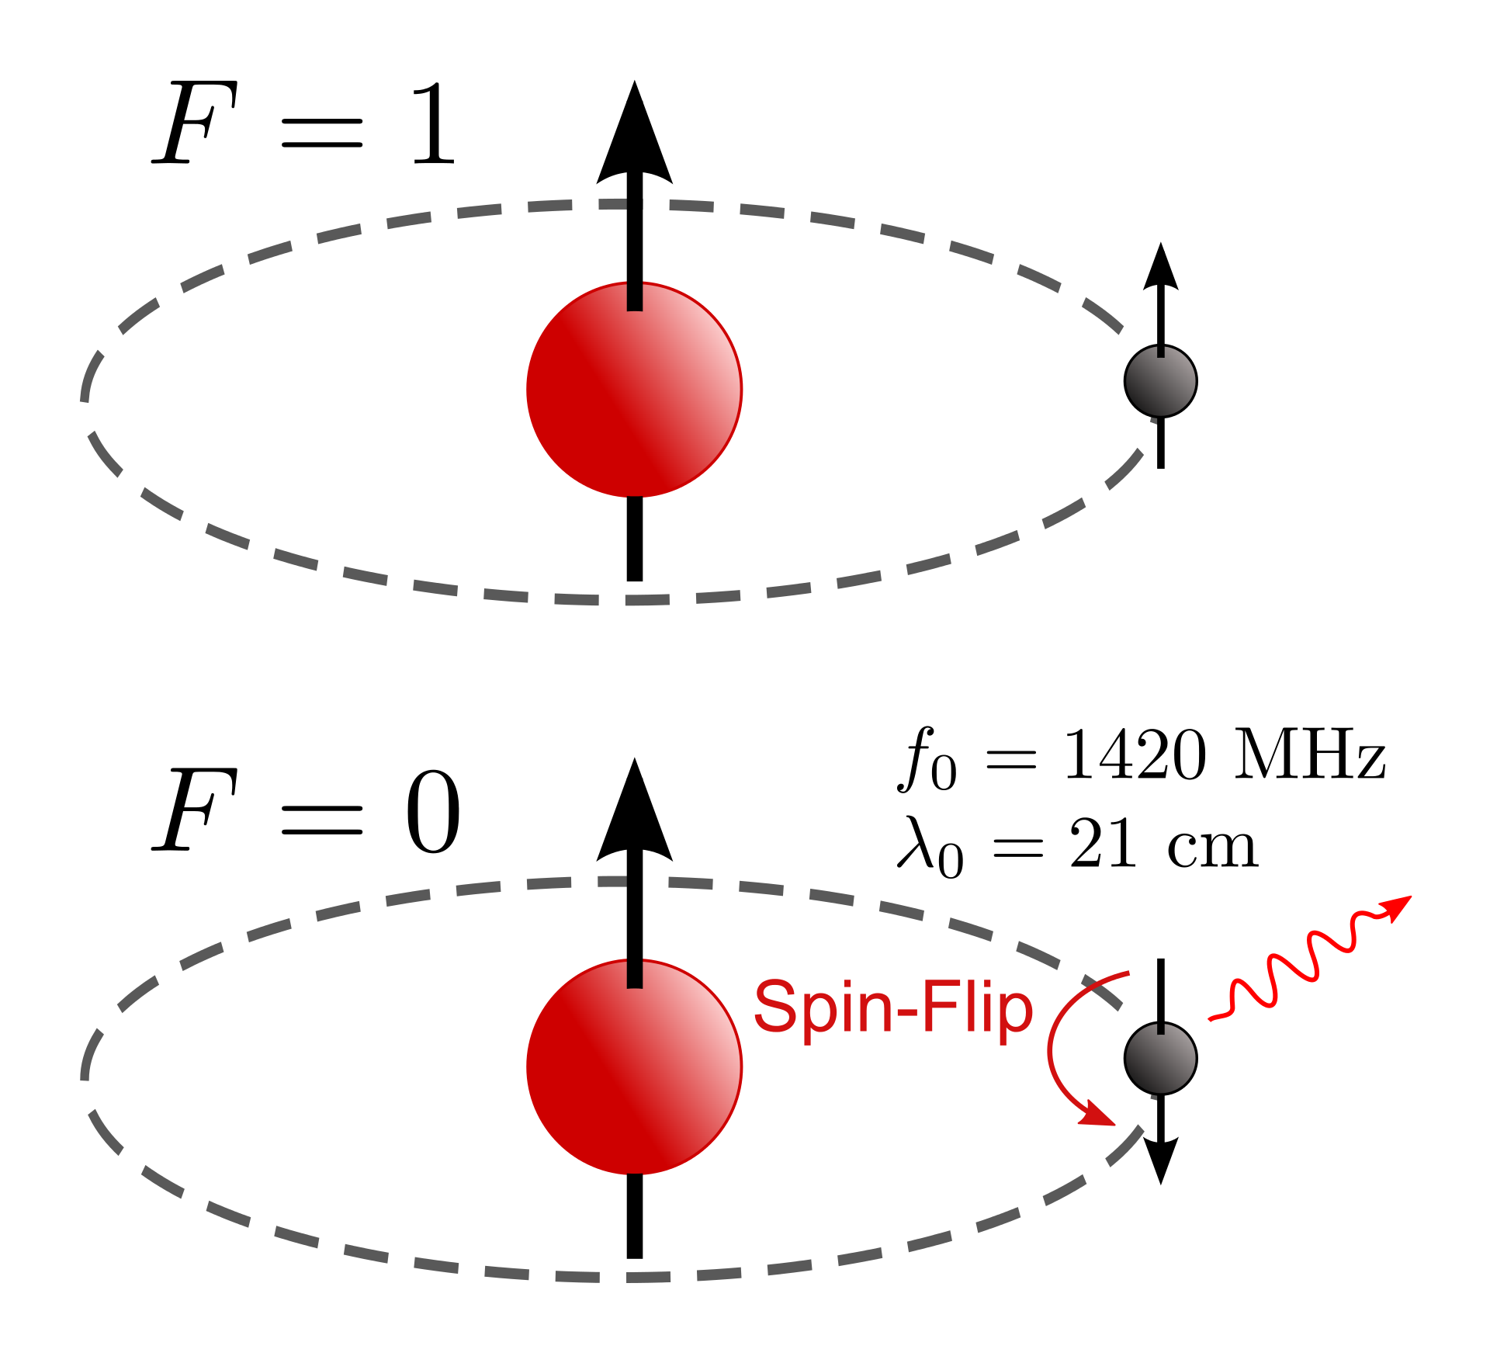
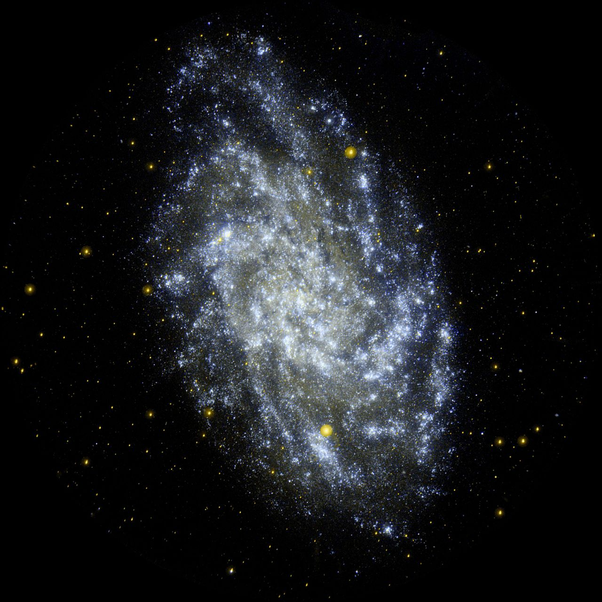
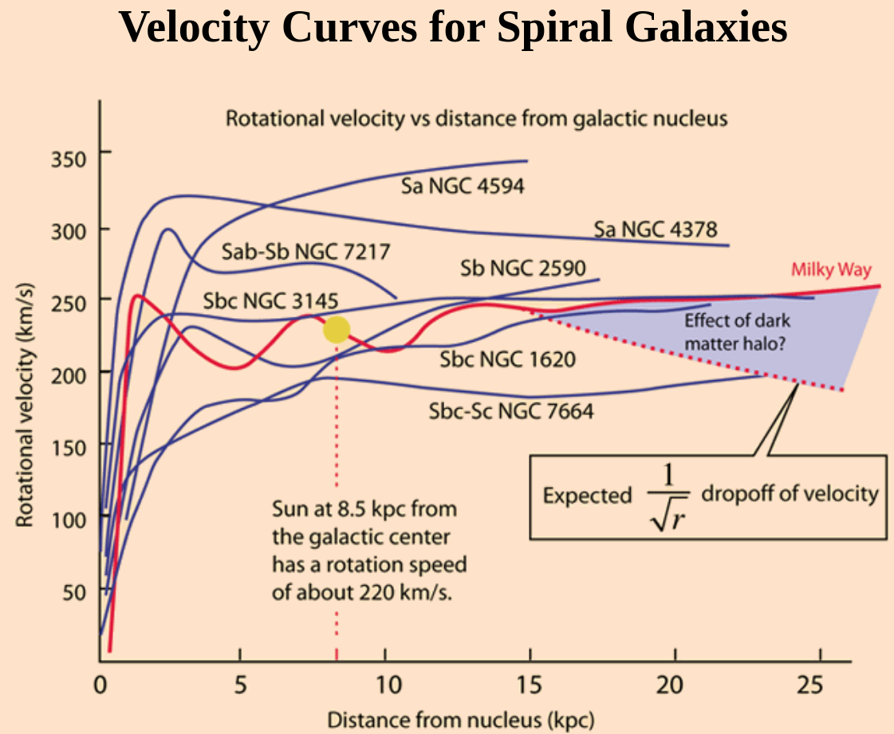
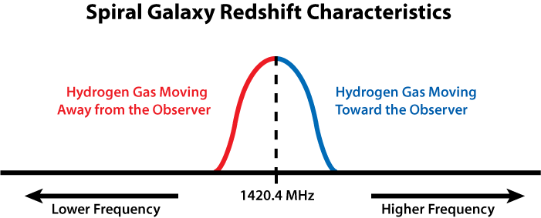
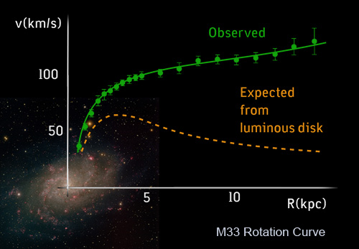
Rotation Velocity
http://hyperphysics.phy-astr.gsu.edu/hbase/Astro/velcurv.html
However: this behavior is not observed in the case of spiral galaxies; instead of the expected fall, the rotation curves all seem to flatten with increasing distance from the centre
Idea: use the neutral hydrogen clouds 21cm radio emission to map the rotational velocity
Hyperfine splitting or “spin flip”: transition to two different spin states of the electron. The motion wrt the observer will cause blue or red-shift (Doppler effect)
Triangulum Galaxy
Astroparticle Physics - Part 4 Introduction to Dark Matter
<number>
Notes:
<number>

Slide 10
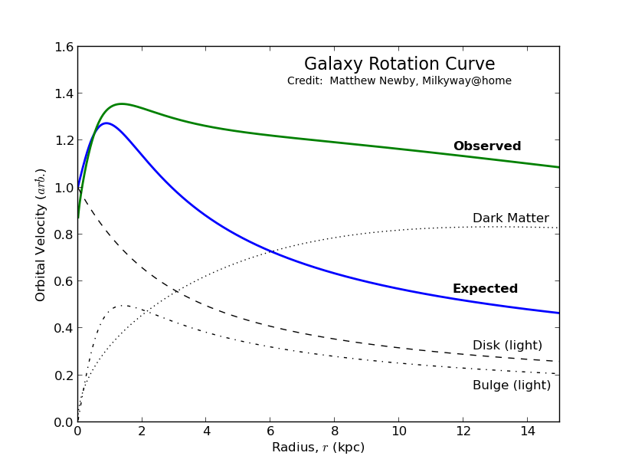
Rotation Velocity
How to explain this
Observe the luminous matter distributions of the two components of the galaxy (i.e. the bulge and the disk)
Calculate the gravitational potential, and resulting velocity distribution of start as a function of the distance
Add the contributions→ they do not match the observations
Add a hypotetical distribution of matter, that is not observed, to produce velocites compatible with observations
Calculations/simulations suggest a presence of a halo of non-visible matter, that surrounds the galaxy, and explain the flattening of the rotation curves
The halo component dominates at large radii, while it is less important near the centre
Astroparticle Physics - Part 4 Introduction to Dark Matter
<number>
Notes:
<number>

Slide 11
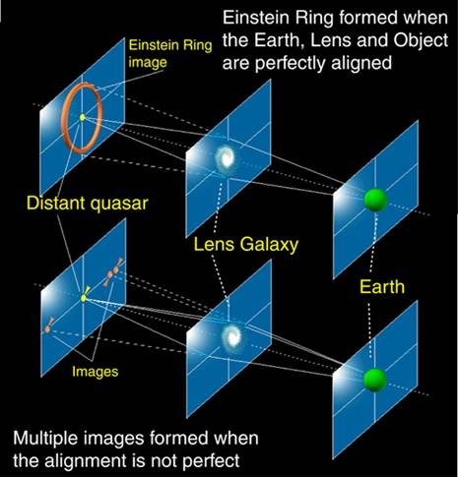
Gravitational Lensing
Yet, another prediction from Einstein general relativity
In the presence of a large mass, the space-time is distorted and particles e.g. photons follow accordingly different geodetics
The image of a distant source (like a quasar) appears on the sky at a different position, or at multiple positions, or distorted due to the intense gravitational field caused by a massive astrophysics placed in between the source and the observer
Depending on the alignment of the luminous source – lensing object – observer, multiple effects are possible
Astroparticle Physics - Part 4 Introduction to Dark Matter
<number>
Notes:
<number>

Slide 12
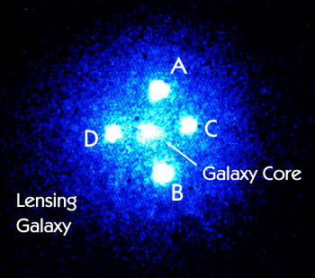
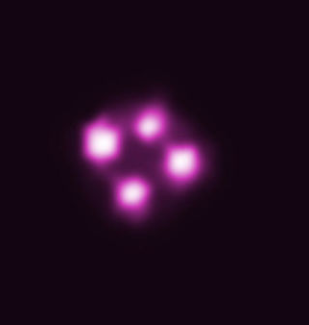
Gravitational Lensing
http://www.astronomy.com/news/2015/04/alma-sees-einstein-ring-in-stunning-image-of-lensed-galaxy
The Einstein Cross (Q2237+030 or QSO 2237+0305) is a gravitationally lensed quasar
Due to strong gravitational lensing caused by the lensing galaxy (Huchra's Lens), the light coming form the quasar splits into four different images
Constraining Quasar Relativistic Reflection Regions and Spins with Microlensing
“The X-rays detected by Chandra are produced when the accretion disk surrounding the black hole creates a multimillion-degree cloud, or corona above the disk near the black hole. X-rays from this corona reflect off the inner edge of the accretion disk, and the strong gravitational forces near the black hole distort the reflected X-ray spectrum, that is, the amount of X-rays seen at different energies. The large distortions seen in the X-ray spectra of the quasars studied here imply that the inner edge of the disk must be close to the black holes, giving further evidence that they must be spinning rapidly.”
https://arxiv.org/pdf/1901.06007.pdf
The above long-exposure photograph shows the position of the lensed images of the quasar
Chandra satellite X-Ray observation
https://chandra.harvard.edu/blog/node/731
https://phys.org/news/2019-03-einstein.html
Astroparticle Physics - Part 4 Introduction to Dark Matter
<number>
Notes:
<number>

Slide 13
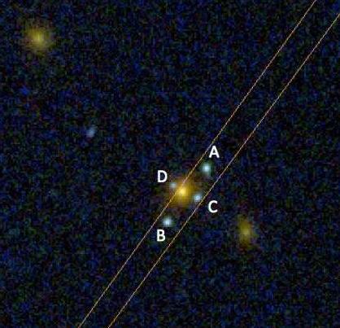
Gravitational Lensing
!!! New Einstein Cross (March 2019) found by The Hubble Space Telescope
https://phys.org/news/2019-03-einstein.html
“ The object acting as a lens turns out to be an elliptical galaxy located at a distance of approximately 7 billion light years (z = 0.556), while the source is at least 20 billion light years away (z = 3.03). "Normally the source is a quasar, it was with great surprise that we realized the source in this case was another galaxy, in fact a galaxy with very intense emission lines which indicates it is a young object still forming large amounts of stars"
[…] Gravitational lenses are important because they allow the study of the Universe in a unique way. Because the light of the different images, initially the same light, follows different paths in the Universe, thus any spectral differences must be due to the material that is between us and the source. Moreover, if the source is variable, we can see a time delay (one image illuminates before the others), which provides valuable information about the shape of the Universe.
Of course, the mass of the lens responsible for bending the light can be accurately derived, providing an important independent method to weight galaxies.
Finally, as with a normal glass lens, the gravitational lens concentrates toward us the light from the source, making it possible to see intrinsically unreachable objects. In this case it could be calculated that the source is 5 times brighter than it would be without the lens. “
Astroparticle Physics - Part 4 Introduction to Dark Matter
<number>
Notes:
<number>

Slide 14
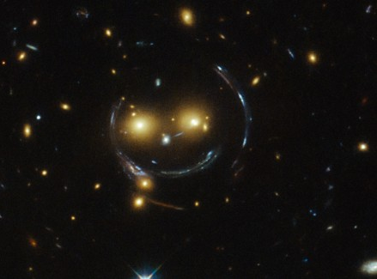
Gravitational Lensing
Astroparticle Physics - Part 4 Introduction to Dark Matter
<number>
Notes:
<number>

Slide 15
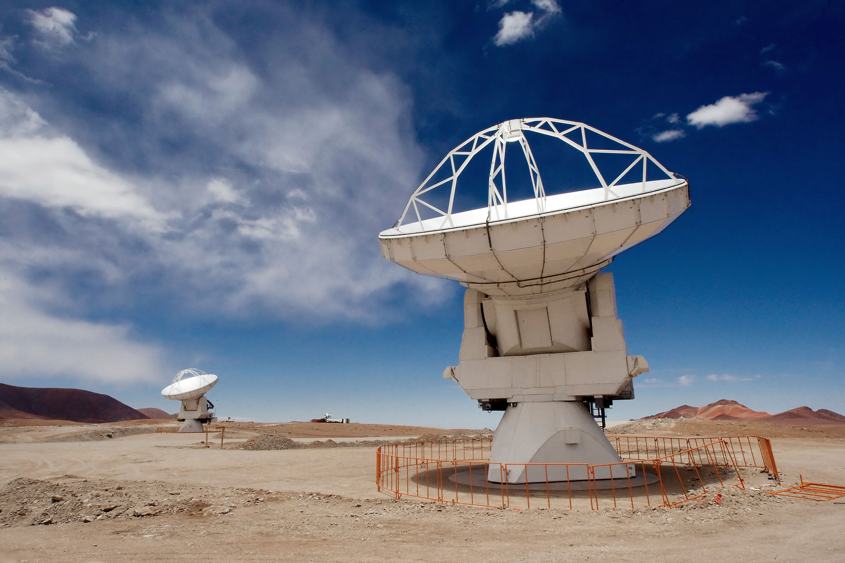
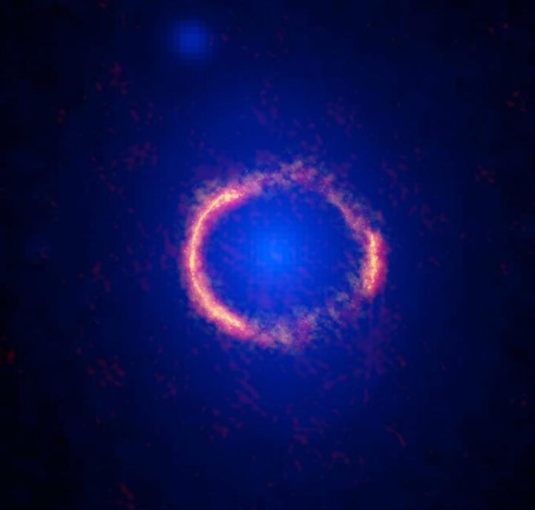
Gravitational Lensing
Atacama Large Millimiter Array (ALMA, Chile)
https://public.nrao.edu/news/alma-ring-lens/#PRimage3
ALMA/Hubble composite image of the gravitationally lensed galaxy SDP.81. The bright orange central region of the ring (ALMA's highest resolution observation ever) reveals the glowing dust in this distant galaxy.
The surrounding lower-resolution portions of the ring trace the millimeter wavelength light emitted by carbon monoxide.
The diffuse blue element at the center of the ring is from the intervening lensing galaxy, as seen with the Hubble Space Telescope.
Astroparticle Physics - Part 4 Introduction to Dark Matter
<number>

Slide 16
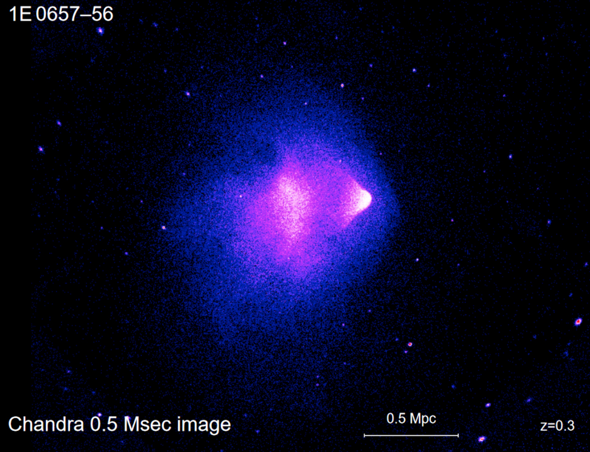
Bullet Cluster (1E 0657–56)
Bullet-shaped hot gas
Shock front
One “smoking gun” of the existence of Dark Matter
It is the smallest cluster of a two cluster systems, which is bullet-shaped
The dynamics of visible components (starts and hot gas) is different from the dynamics of Dark Matter
The study of gravitational lensing produced by the system can be explained only by the presence of two DM Halos
The lensing is strongest in two separated regions, which do not overlap with the X-ray emission (from the hot gas) i.e. the centre of mass ODF the baryonic matter
One of the strongest evidence against alternative gravitation theories (like MOND, Modified Newtonian Dynamics)
It is possible to derive a model independent DM annihilation / interaction cross section upper limit
Astroparticle Physics - Part 4 Introduction to Dark Matter
<number>
Notes:
<number>

Slide 17
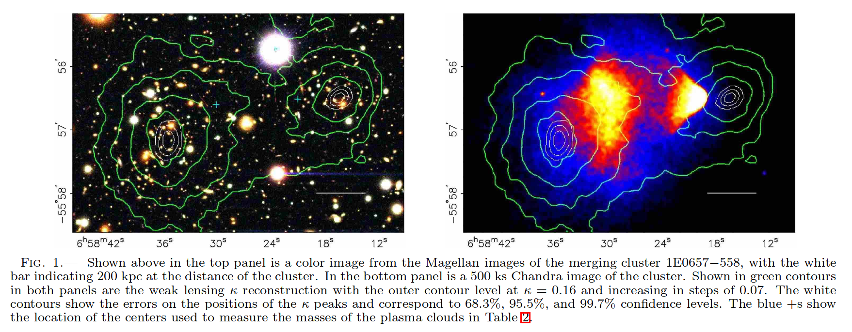
Bullet Cluster (1E 0657–56)
A DIRECT EMPIRICAL PROOF OF THE EXISTENCE OF DARK MATTER
https://arxiv.org/pdf/astro-ph/0608407.pdf
“We present new weak lensing observations of 1E0657−558 (z= 0.296), a unique cluster merger, that enable a direct detection of dark matter, independent of assumptions regarding the nature of the gravitational force law. Due to the collision of two clusters, the dissipationless stellar component and the fluid-like X-ray emitting plasma are spatially segregated. By using both wide-field ground based images and HST/ACS images of the cluster cores, we create gravitational lensing maps which show that the gravitational potential does not trace the plasma distribution, the dominant baryonic mass component, but rather approximately traces the distribution of galaxies. An 8σ significance spatial offset of the center of the total mass from the center of the baryonic maspeaks cannot be explained with an alteration of the gravitational force law, and thus proves that the majority of the matter in the system is unseen.”
Astroparticle Physics - Part 4 Introduction to Dark Matter
<number>
Notes:
<number>

Slide 18
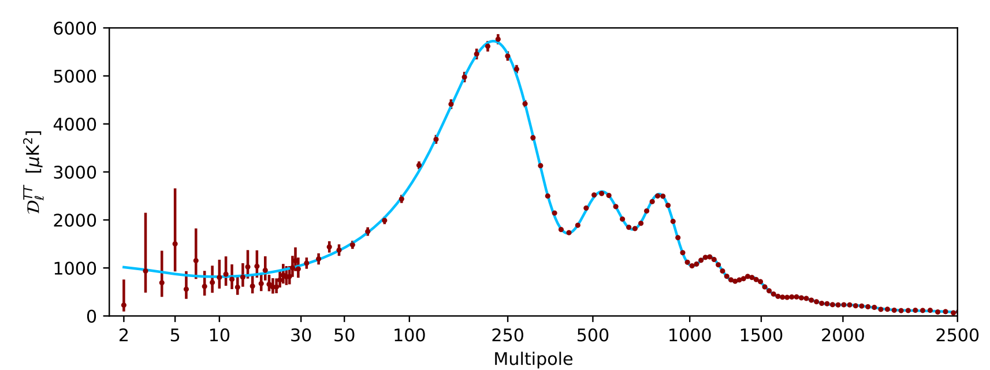
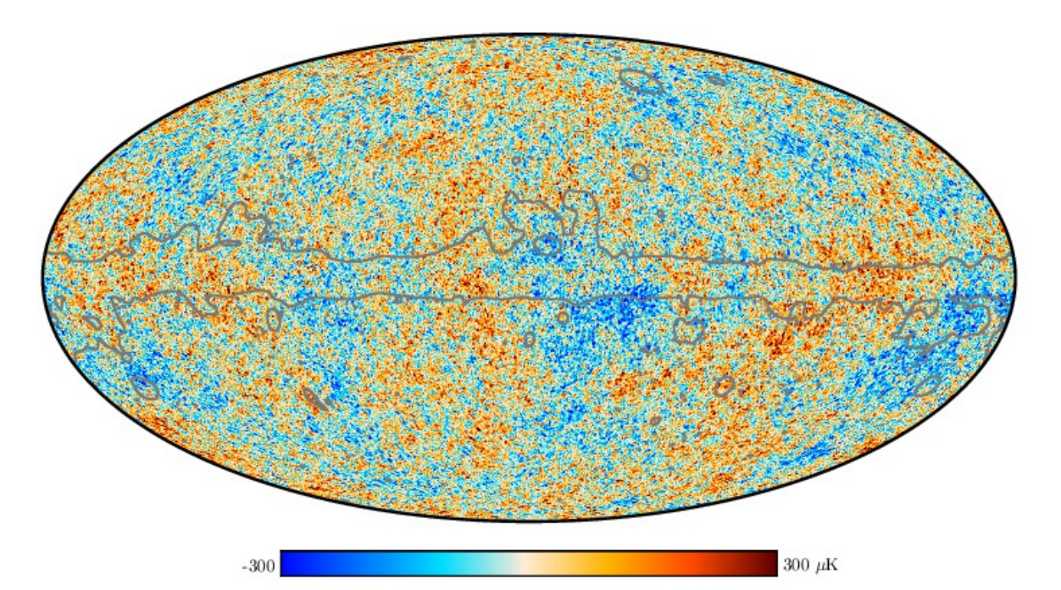
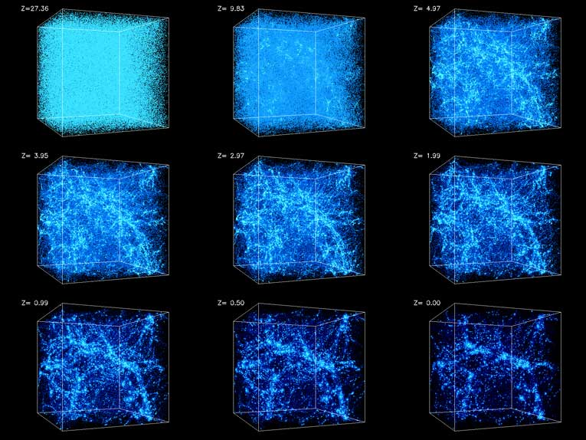
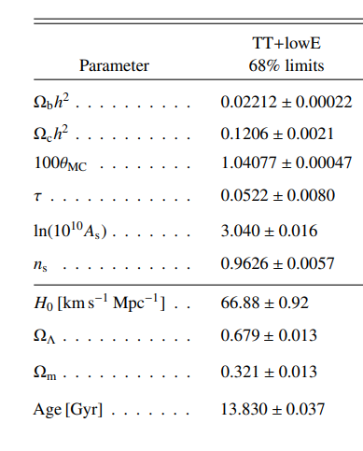
DM in the Cosmic Microwave Background and in Cosmology
CMB Spectrum
Planck 2018 Legacy Results
Baryonic component
DM component
Dark Energy component
DM + Baryons
Large Scale Structure of the Universe and Structure Formation
Astroparticle Physics - Part 4 Introduction to Dark Matter
<number>

Slide 19
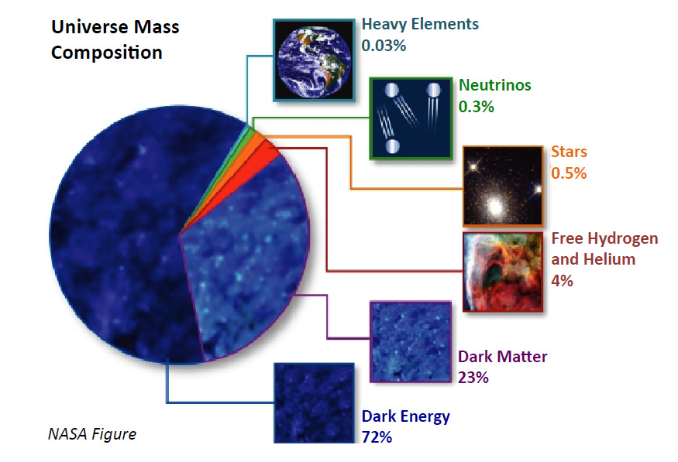
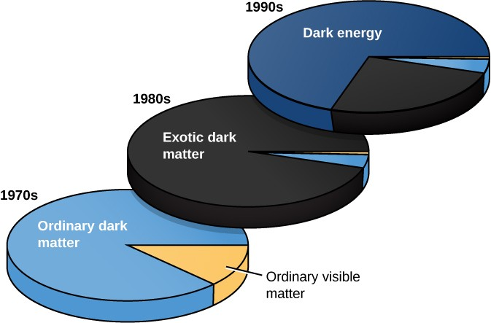
DM in the Cosmic Microwave Background and in Cosmology
( Numbers ~ change according to the experiment taken into account )
Astroparticle Physics - Part 4 Introduction to Dark Matter
<number>

